Slide 2
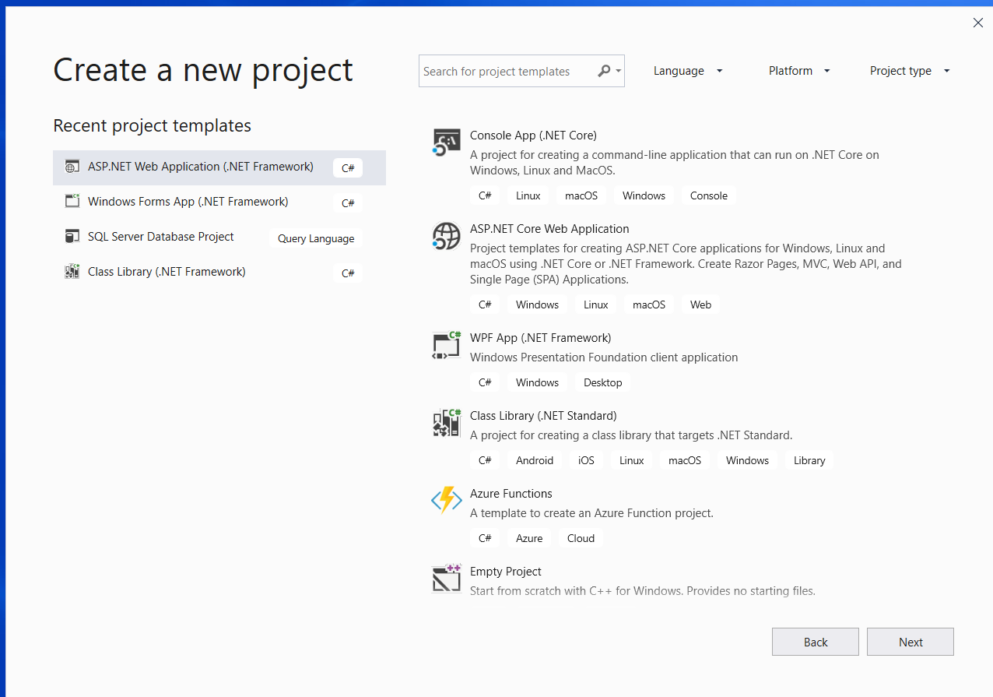

Slide 3
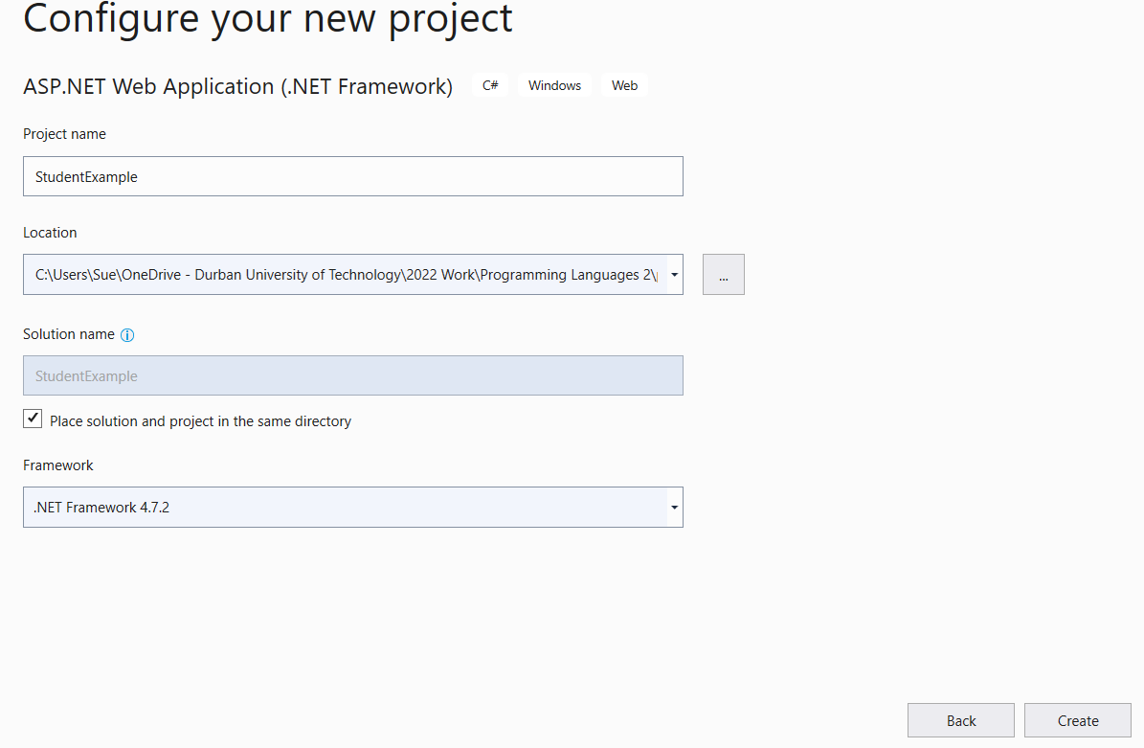

Slide 4
Select MVC

Slide 5
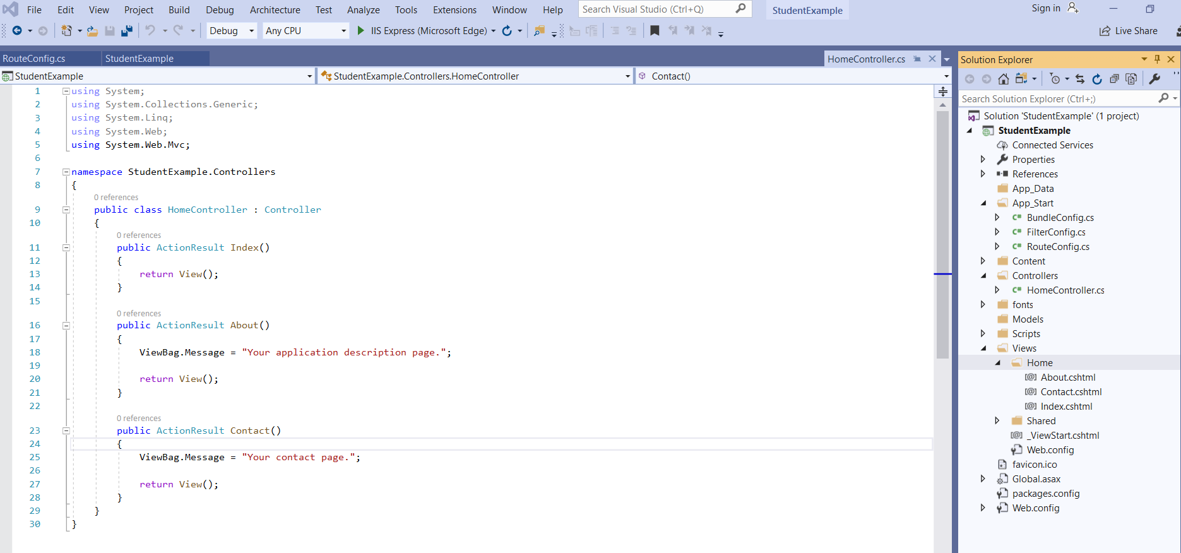

Slide 6
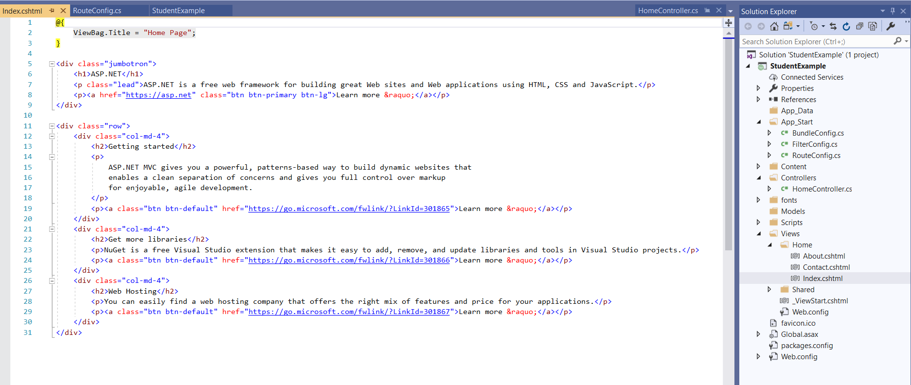

Slide 7
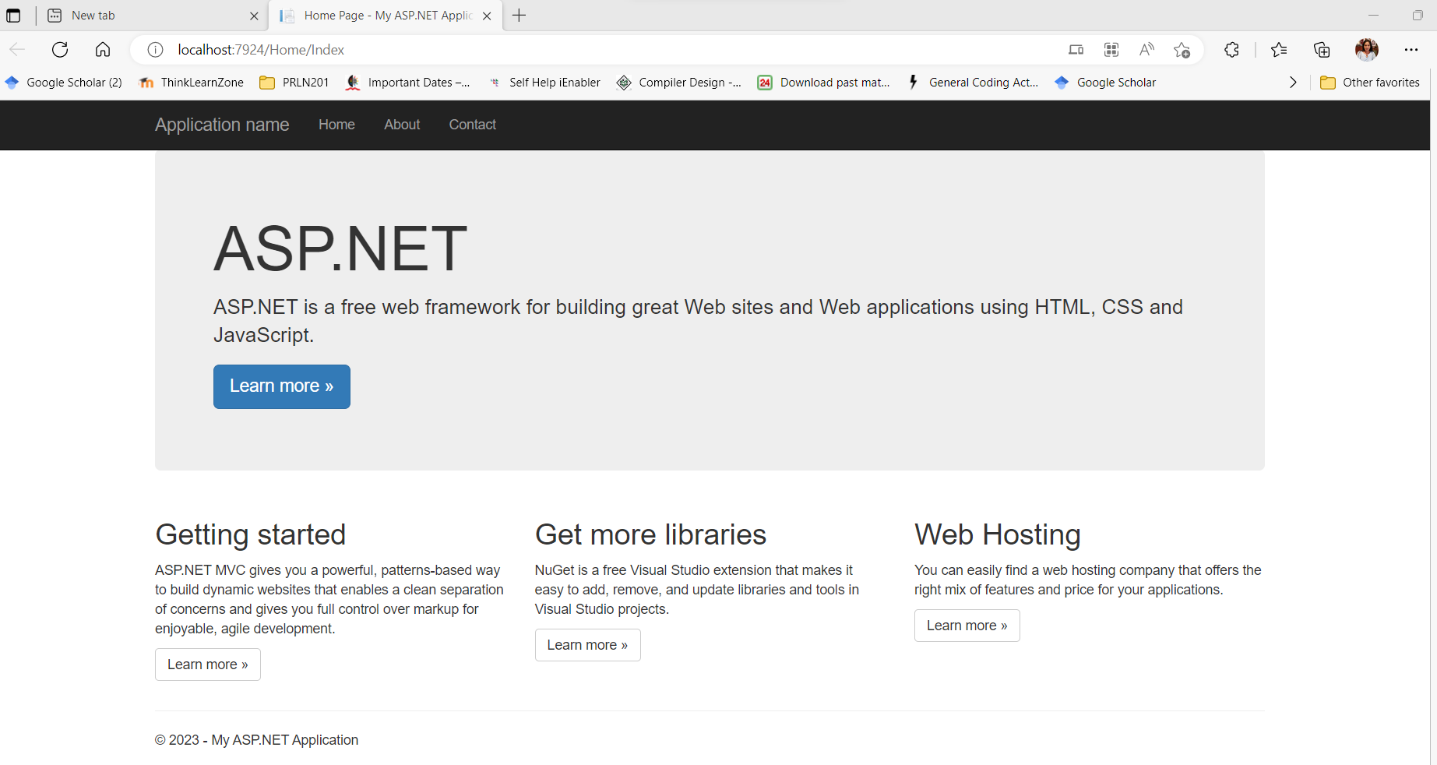

Slide 8
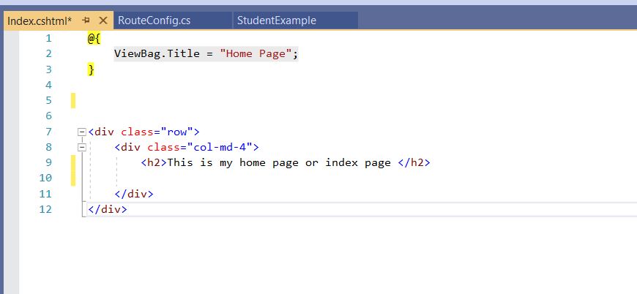

Slide 9
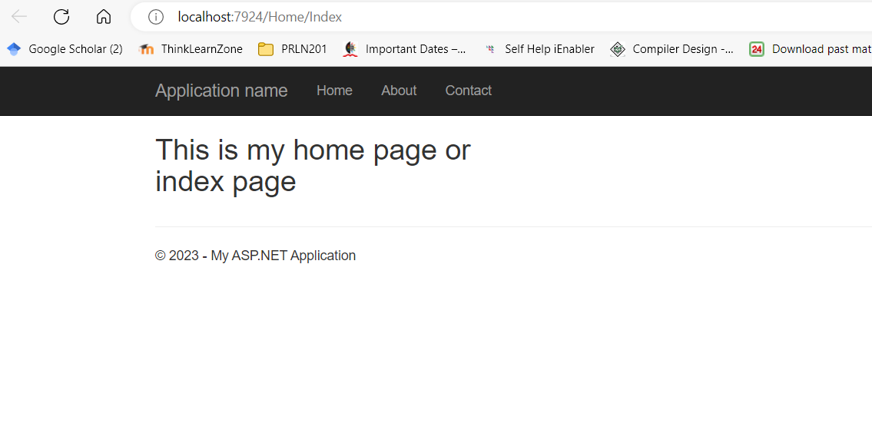

Slide 10
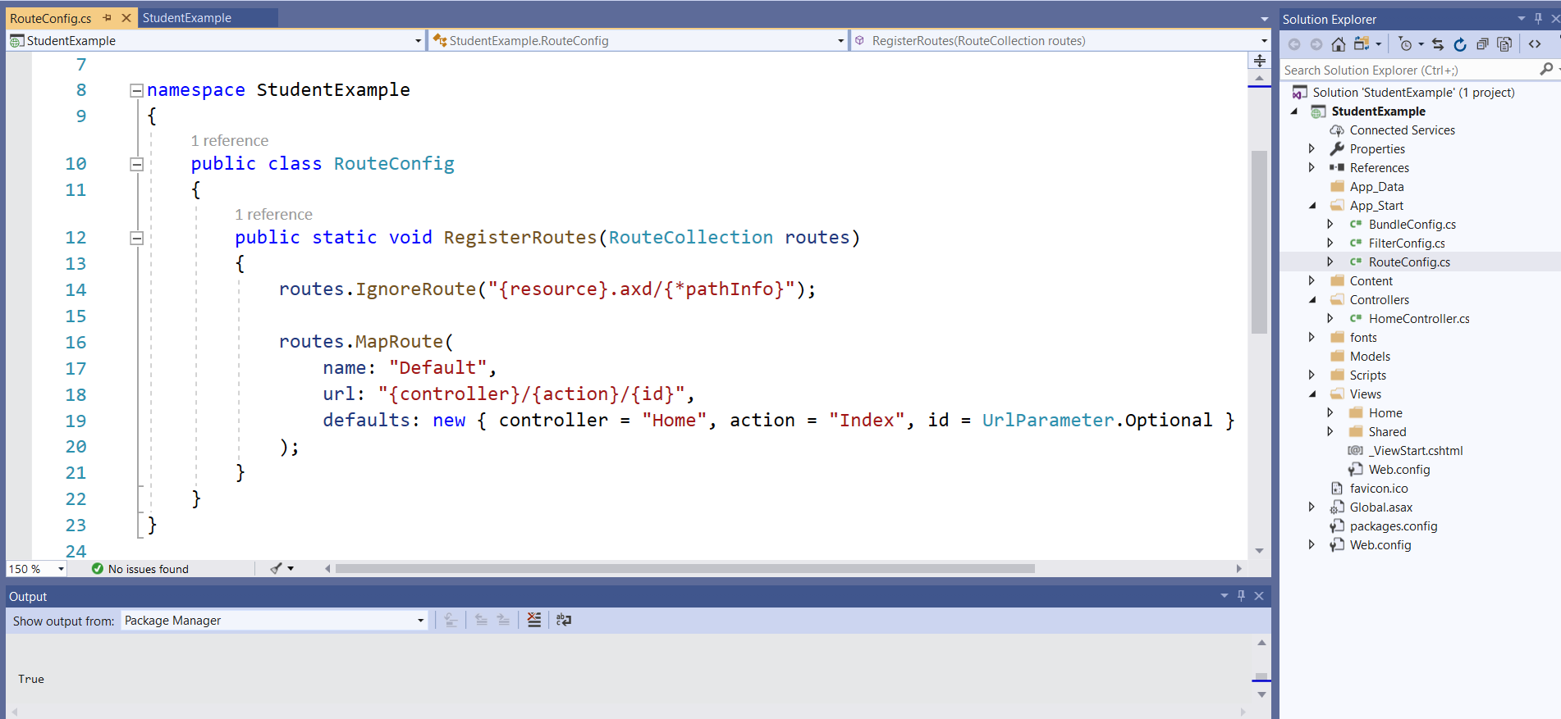
App_Start\RoutConfig.cs – is the routing file that map routes from the page the user requests
to the controller that will handle the request

Slide 11
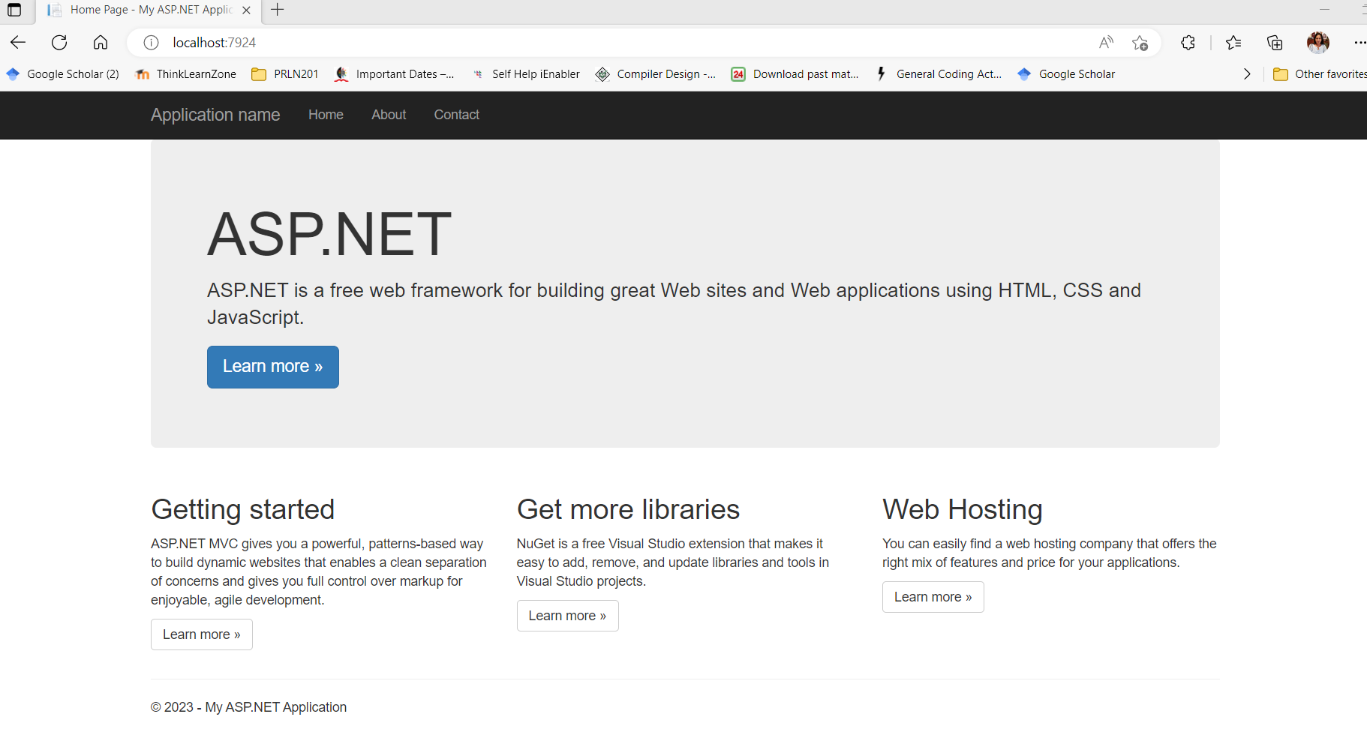

Slide 12
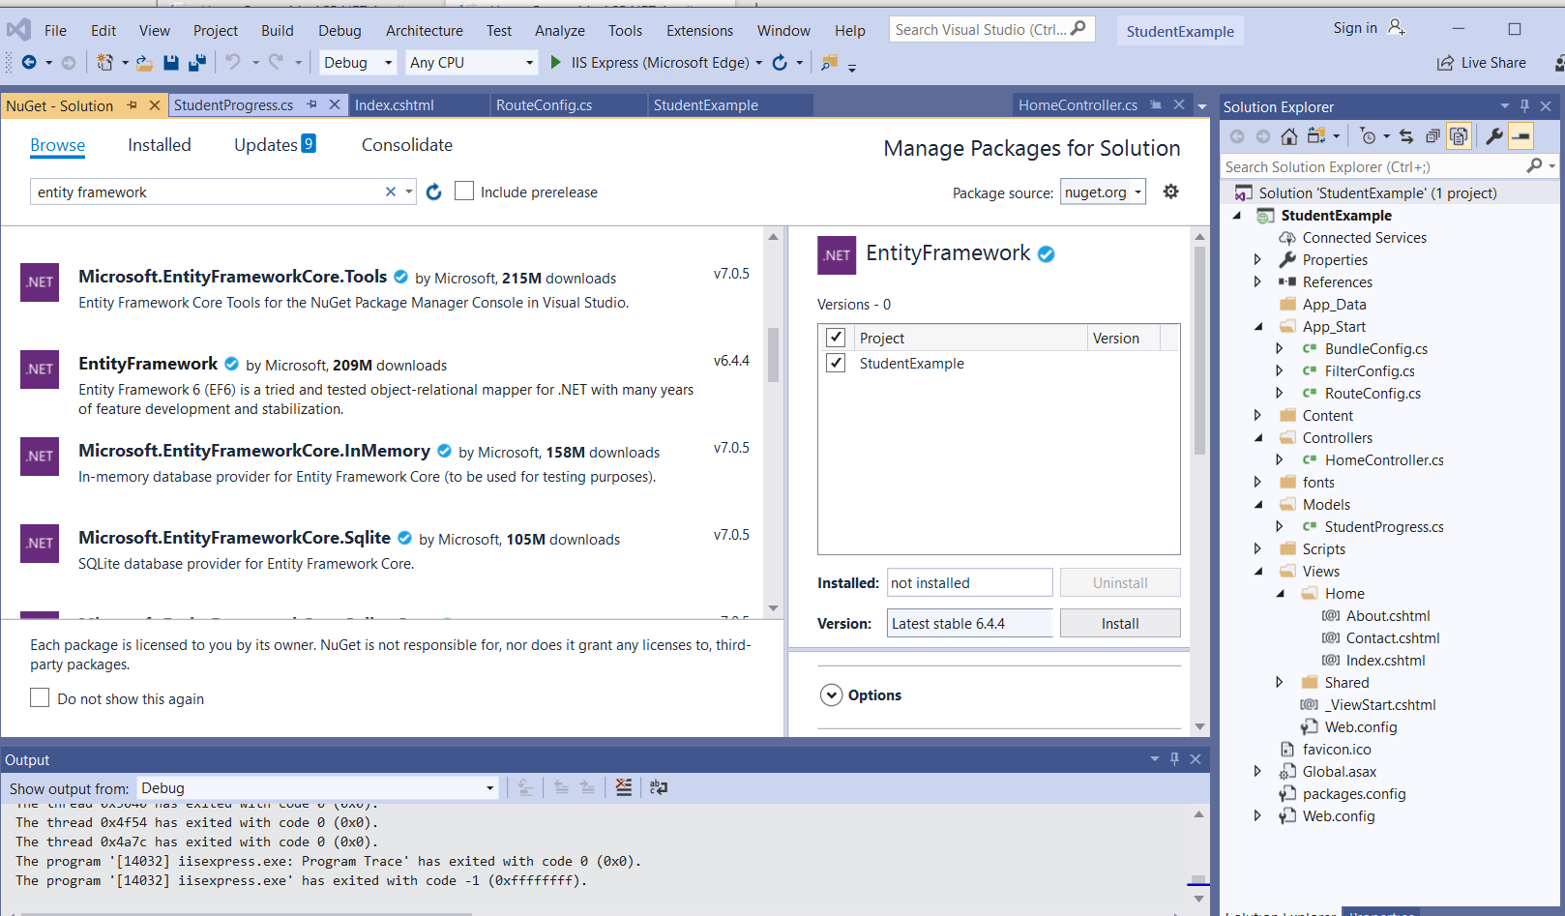
Use NuGet Manager to add Entity Framework

Slide 13
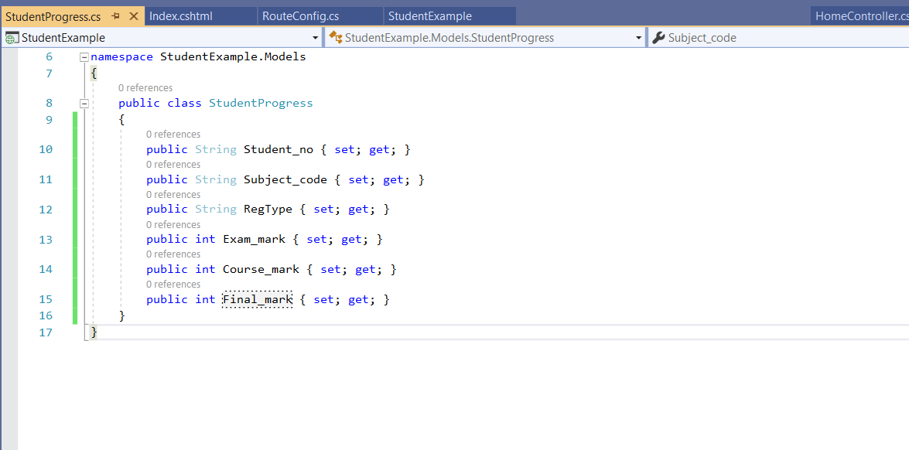
Add a Model Right click on Models, Select Add, then Class

Slide 14
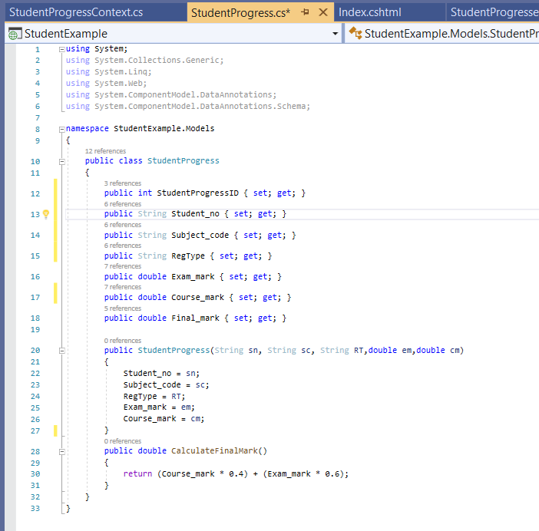
We added an ID field to uniquely identity this
record-since a student will register for more than 1 subject. Autogenerated fields must be int.
We added a constructor

Slide 15
We added an ID field to uniquely identity this
record-since a student will register for more than 1 subject. Autogenerated fields must be int.
We added a constructor – notice that we left out final mark
since we want our system to calculate that

Slide 16
We added an ID field to uniquely identity this
record-since a student will register for more than 1 subject. Autogenerated fields must be int.
We added a constructor – notice that we left out final mark
since we want our system to calculate that
The method will be used to calculate the Final Mark

Slide 17
We added 2 libraries which will allow us to
add validation instructions for our class – Data Annotations
We added an ID field to uniquely identity this
record-since a student will register for more than 1 subject. Autogenerated fields must be int.
We added a constructor – notice that we left out final mark
since we want our system to calculate that
The method will be used to calculate the Final Mark

Slide 18
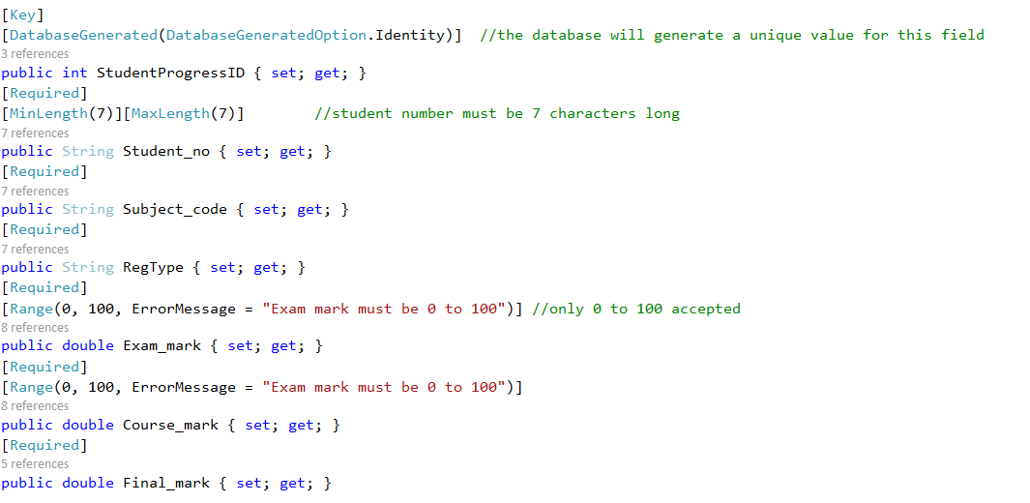
Adding Data Annotation

Slide 19
Save the file Add another class file to the models folder and call it StudentProgress Context.cs

Slide 20
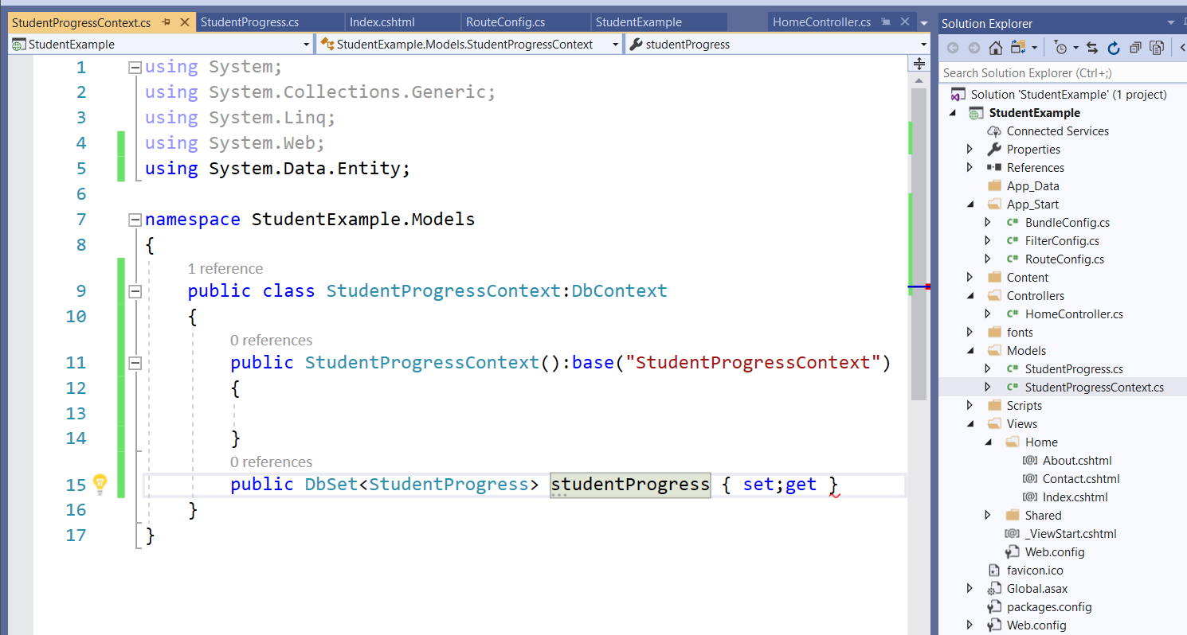

Slide 21
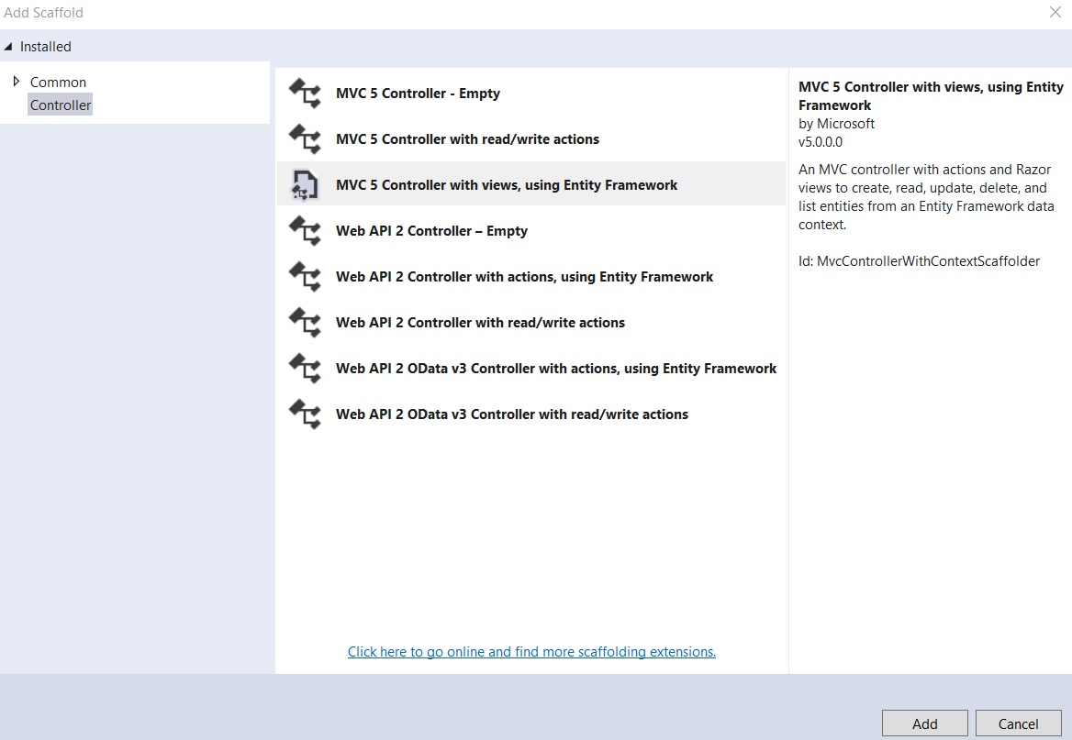
Now we need a controller

Slide 22
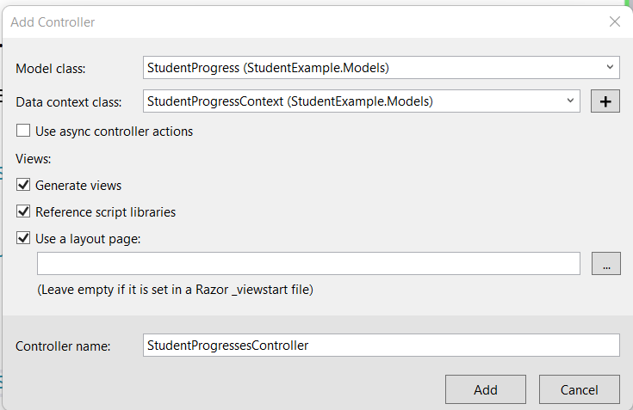
Now we need a controller
Select the Model on which the website will be based
Select the Context file which will help Visual Studio generate a Database with a table for data.
When you click Add …. The controller is created AND Visual studio generates Views for your application to
View, Delete, Update and Create records to be saved in the database.

Slide 23
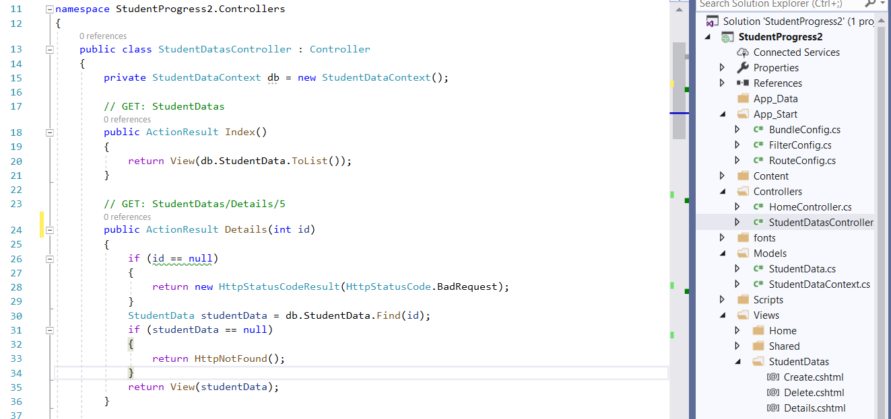

Slide 24
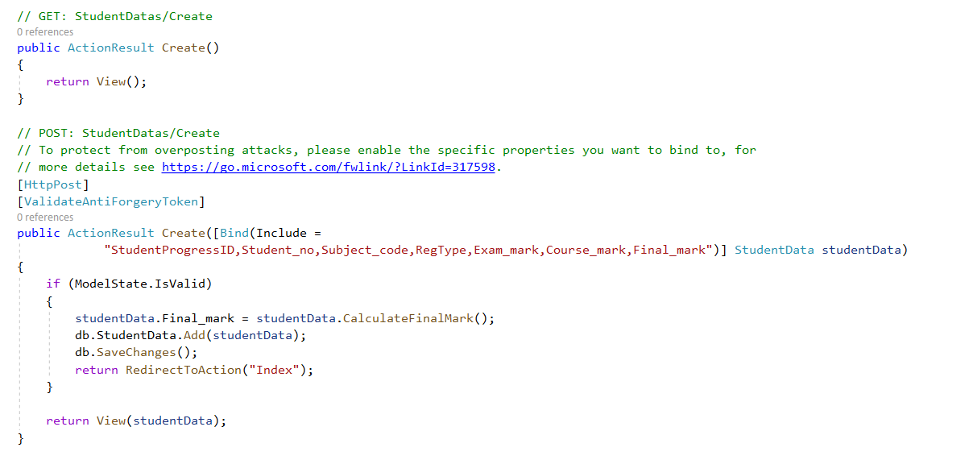
Look at the Create Action Method : There are 2 with the same name. However one of them is qualified by the [POST] keyword

Slide 25
Look at the Create Action Method: There are 2 with the same name. However one of them is qualified by the [POST] keyword
The studentData object we are using is a parameter that Visual studio created to accept all input relating to the Model that was posted from the View – ie the user entered this info on the webpage

Slide 26
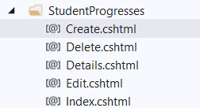
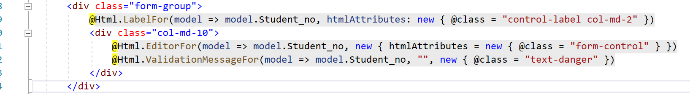
The Views
A separate view has been created for Create, Update, Delete, Details, Index The Create Page, displays a form with textfields that a user can input data
Visual Studio has inserted Razor Syntax to add each property defined in the model. For each property (except databasegenerated ones) there is a :
@Html.LabelFor -- Text appears next to the textbox
@Html.EditorFor --makes a textbox for user input
@Html.ValidationMessageFor -- Creates a message output when invalid input

Slide 27
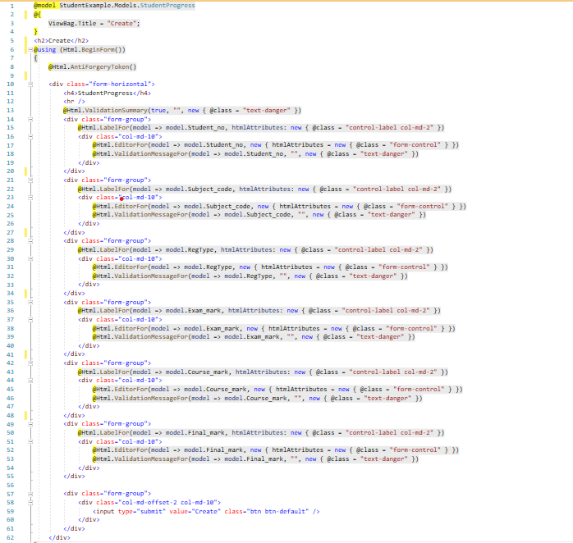
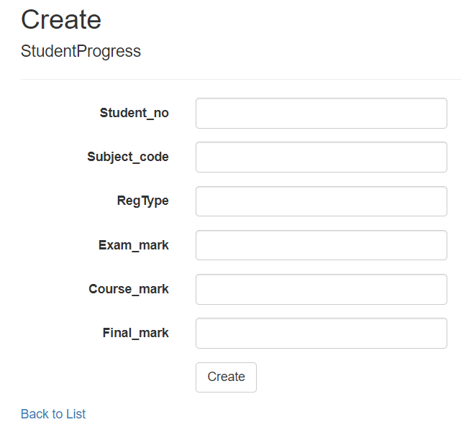
Create View
Generated by Visual Studio

Slide 28
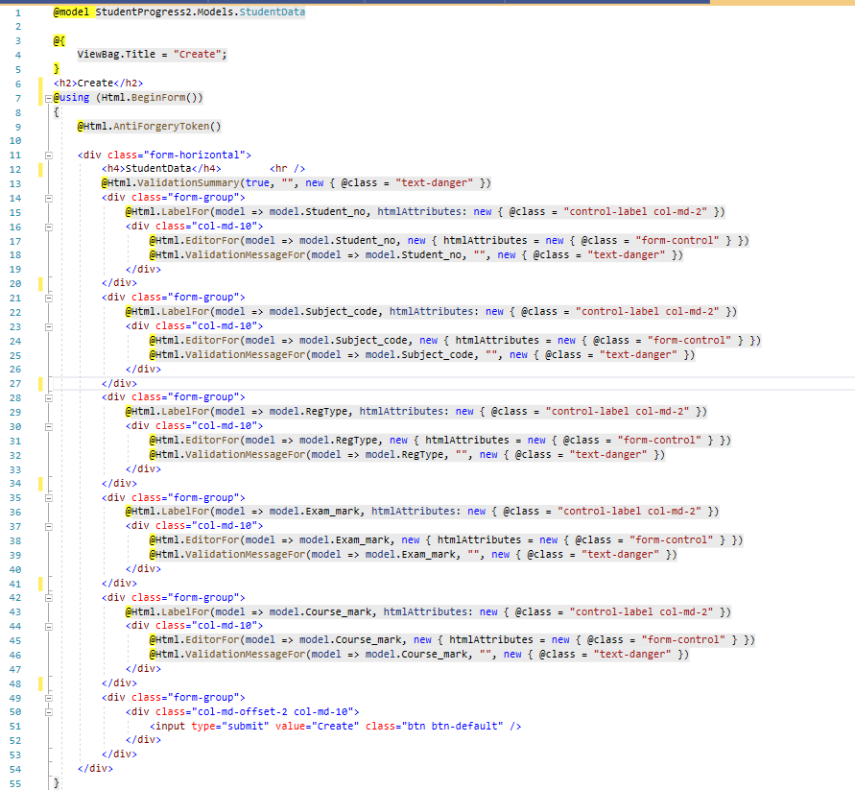
Create View
Notice that we have now removed the input box for the final mark because we want to calculate that in the program

Slide 29
How do we change the record before adding
We add any calculation statement before adding to the database.
This line that will first calculate the final mark using the function

Slide 30
Now run the application
For now you can make sure that you are inside the create view when you run
You will learn how to edit the routeConfig file in the next slide

Slide 31
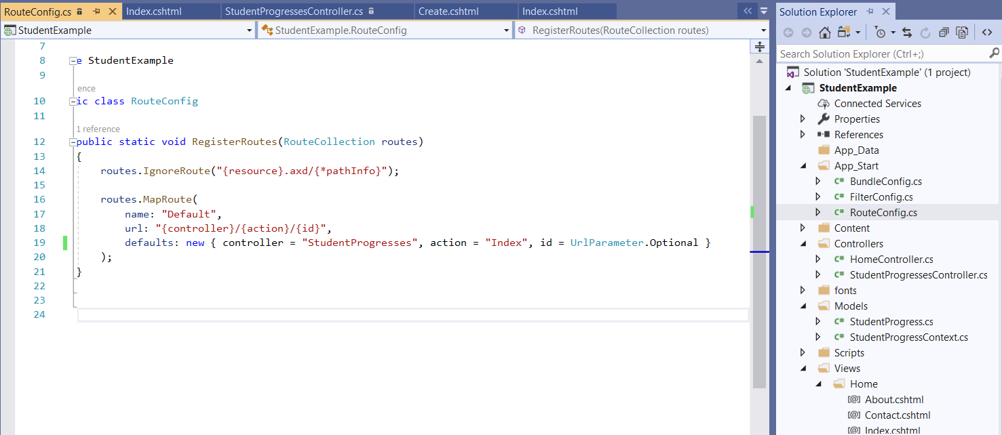
AppData / RouteConfig
Edit the RoutConFig file. Change the controller to the same name as what you named your new controller. This
Will make the website automatically load the Index view from the new controller instead of the original Home controller

Slide 32
Now run the application
You can run the application from any view you have created

Slide 33
Complete tutorial 9

